Slide 1
Mojaloop - TigerBeetle
Integration
PI-20 Community Meeting
26 October 2022
Jason Bruwer, Matseliso Thabane
Notes:
Hi Everybody,
Welcome and thank you for joining the TigerBeetle update in lovely ZanzibaRRRRR!!!
I hope you all had a good lunch and filled up with coffee for the TigerBeetle update.
Myself (Jason) and Tseli will be doing the presentation today.

Slide 2
Agenda
Business Drivers
PI-19 Progress
Constraints
Demo (Settlement)
Next steps & Questions
Notes:
Business drivers
Why are we doing this work, and what will be the impact thereof.
PI-19 progress
The progress that has been made thus far..
Constraints
The current constraints we are working through.
Demo
A demo of settlement using TigerBeetle.
Conclusion
The next steps forward for Mojaloop and TigerBeetle

Slide 3
Business Drivers
Why are we doing this work?
Performance
Cost
Impact of work:
Business
Development
Notes:
Why are we doing this work?
We drew inspiration from 2 areas:
Performance POC:
In 2020, one of the community workstreams reviewed the performance of the core services of a Mojaloop solution.
One of the lessons learned was that the services that handle Transfers and Settlement are some of the most resource intensive.
We learned that the application makes between 15 and 20 interactions with the database per transfer, and so the lesson was that higher transaction volumes would begin to require a greater allocation of storage, processing and network resources.
The second point of inspiration was the Total Cost of Ownership for doing development work and running a Mojaloop switch:
One of the challenges we had when setting up a Dev environment was that, when running a K8s cluster on a cloud service like AWS, the average monthly cost for AWS services begin to add up.
For a development environment, the average cost was $10 to $15 for an AWS instance running only the services for Transfers and Settlement. We realised that the costs would begin to add up for several environments needed for development, QA, pre-Prod.
So, our goal is to propose TigerBeetle as a high-throughput, low-latency database as a building blocks of the Mojaloop central services, where the impact is to:
Impact:
Reduce the data footprint that is required for storing transfers
Reduce the network capacity that is required and improve latency for clearing and settlement.
These two points should help us reduce the total cost of ownership as fairly low-spec (and therefore low cost) resources are needed for development, test and Prod environments.
Improve developer experience by
simplifying deployment to a single binary that has minimal OS dependencies
Simplify implementation & expertise required for adoption.

Slide 4


PI-19 Goals & Progress
Goal | Integrate TigerBeetle into Mojaloop
Key Objectives | Design document Development for Central-Settlement Regression & integration tests | Integrate into vNext * Demonstrate settlement (*workaround)
Roadmap & Risks / Issues | Roadmap Remove data duplicated in SQL Integration review for Production readiness | Risks / Issues TigerBeetle production readiness
Define Success | Add full test suite Complete implementation guide Quantify settlement performance Report total cost of ownership impact DA, Product Council & community review & approval process
Notes:
So, what have we covered in the previous PI?
1. Updating the solution design document for Central-Settlement integration.
2. We have also completed Dev work for the sttl integration.
3. Regression testing is successful, this executes the 120 existing integration tests and then we added 23 new test cases - golden path.
4. We set out to collaborate with the vNext Build workstream to integrate TigerBeetle into 2 of the 3 functional areas that can use TigerBeetle. We just want to recognise the folks working on vNext Build workstream, including Goncalo and Pedro, for integrating TigerBeetle into the Participants BC & the Accounts & Balances BC in just under 200 lines of code.
5. And then, finally we set out to give a demo of the Settlement service running TigerBeetle. - that is coming right up, with Jason.
So, what does success look like?
We have a fuller set of integration tests to run, including negative testing
We want to quantify the overall performance impact for both clearing and settlement
We’d also like to report on the impact on resource requirements and the cost of setup
We look forward to the process with the DA and the Product Council so that we can receive review, feedback, guidance for this work to become a contribution in the code repo.
Complete an Implementation Guide that documents the impl. steps for the current Prod. version and for vNext.

Slide 5
Constraints
Need to expose TigerBeetle Transfer timeouts via API (beta). Currently dependent on SQL for Transfer timeouts.
Remove data duplicated in TigerBeetle & SQL by introducing TigerBeetle range queries.
Notes:
Two items in Development with the TigerBeetle are needed to complete our integration work:
The first is making API calls available when TigerBeetle manages transaction timeouts. Our current workaround for the demo still relies on SQL for transaction timeouts.
The 2nd item is richer query functionality beyond the current lookup based on transaction ID. Extended query capabilities will enable the settlement integration to rely on TigerBeetle only for data that currently resides in about 9 SQL tables.

Slide 6
Settlement Process
Initialize
Clearing
Settlement
PENDING_
SETTLEMENT
Infra Setup
Cleared transfers allocated to a settlementWindow
Trigger - Create accounts
TRANSFERS_RECORDED
Configure
Prepare - Create settlement obligations
TRANSFERS_RESERVED
Test Data
Reserve - PAYEE fulfils obligation
TRANSFERS_COMMITTED
Commit - PAYER fulfils obligation
Validate - transfers committed & settlement windows closed
SETTLED
Notes:
Settlement Process
A quick recap of the Mojaloop settlement process and overview of the demo.
The initialize process for the integration test will create all the necessary initialization data as well as the accounts and environment configurations.
We will then have 3x transactions, each allocated to a settlement window.
Finally, we will go through the process of settling the cleared transactions.
The process involves, settlement account created, creating the settlement obligations and then finally, fulfilling the settlement obligations.
Clearing
Before we can get to settlement, we first require cleared transactions that can be settled.
Settlement windows are associated with transfers during clearing
Trigger Settlement - triggerSettlementEvent
The purpose of the trigger event, is to create the necessary Hub and DFSP accounts for settlement. Multiple settlement windows may be settled as part of a settlement event.
Settlement accounts are created for each applicable DFSP, along with the hub currency accounts, if they do not exist yet.
Update Settlement (putById)
Update settlement will process and update the settlement, depending in what state the settlement is currently in.
For the events below, it is assumed that the settlement model configuration autoPositionReset is enabled.
Prepare - settlementTransfersPrepare
The state of the settlement is currently in a PENDING_SETTLEMENT state. The prepare is responsible for creating the settlement obligation for Payer and Payee.
Hub account is debited, whilst DFSP settlement accounts are debited and credited
Duplicate records for transferParticipant is avoided by TigerBeetle built in functionality
Reserve - settlementTransfersReserve
The settlement reservation will only be processed in the event of a “settlement net recipient” state (net amount after prepare was less than 0)
Limit check against the net debit cap is verified at this stage if requireLiquidityCheck feature is enabled.
A 2-Phase TigerBeetle settlement transfer is performed against the Hub and DFSP settlement accounts.
TigerBeetle calculates the available balance based on the pending/posted credit and debit balances for Position and Settlement accounts for each participant
Commit - settlementTransfersCommit
The pending transfer created as part of the reservation step, will now be committed to effect the reserved and committed balances for the Hub and DFSP accounts.
The available balance for the participant is restored - settlement account credit and debit balance are 0
Settlement status will be updated in the MySQL tables
Demo Breakdown
Settlement models, currently bilateral net/deferred and multilateral deferred is supported, however, additional configurations may be made for the settlement models, which is kept in MySQL.
triggerSettlementEvent - Multiple settlement windows may be settled in a single settlement, the window being processed here is window 1. The reason data for the settlement event is kept in MySQL, along with the created date-time and settlement model being applied. In future, the settlementWindowId will be used as range query lookups.

Slide 7
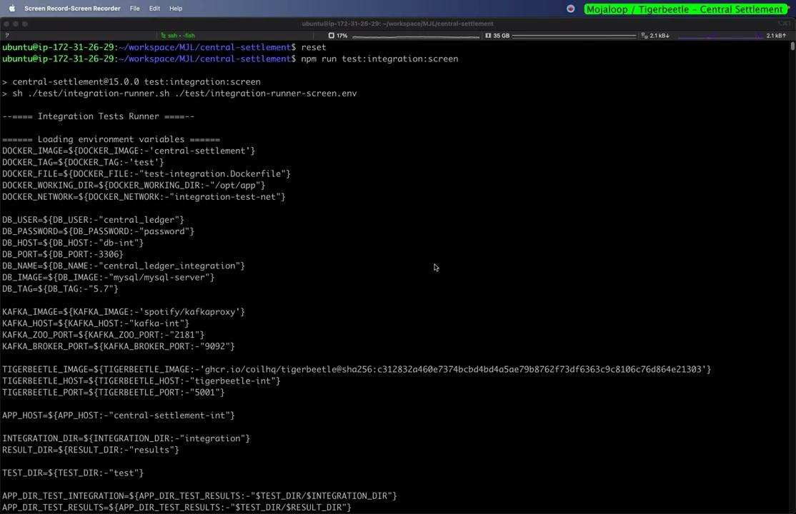

Demo - Clearing & Settlement
https://drive.google.com/file/d/1a7NesrbntvHyxzCpsIk7X6Hd7abJ6tpX/view?usp=sharing
Notes:
Init Environment
Building of central-settlement docker image, running the Docker MySQL, CL, MJL-API etc. containers, Database initialization.
Integration Tests Starting with 3x Clearing Transfers
Health Check, 3 transfers, 1 Euro and 2 USD
TigerBeetle Pre-Checks with Settlement Window, Content and Aggregation Data
Integration check to verify all TigerBeetle configurations are correct. Create the settlement Window, Content and Aggression Data.
Event - triggerSettlementEvent
Create Hub Mutlilateral / Recon and DFSP Accounts. PENDING_SETTLEMENT status
Event - settlementTransfersPrepare
Create settlement obligation for Payer and Payee. PS_TRANSFERS_RECORDED status
Event - settlementTransfersReserve
Settlement event to fulfill Payee’s settlement obligation, as well as perform Net Debit Cap check to ensure DFSP is within hub limits. PS_TRANSFERS_RESERVED status
Event - settlementTransfersCommit
Settlement event to fulfill Payers settlement obligation. PS_TRANSFERS_COMMITTED, whilst settlement is in a SETTLED status
Teardown
Other transfers for USD, test cases passed, teardown of docker environment

Slide 8
Next Steps
Upgrade TigerBeetle to resolve the 2 constraints.
Complete settlement integration & expand testing.
Quantify performance.
Initiate community review process.

Slide 9
Thank you.

